Slide 1
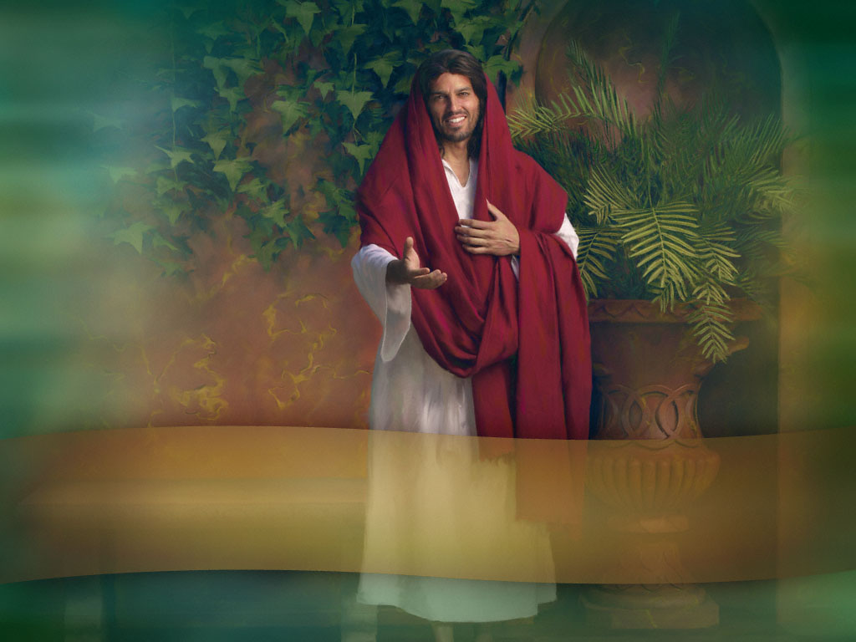
THE CALL FROM JESUS

Slide 2

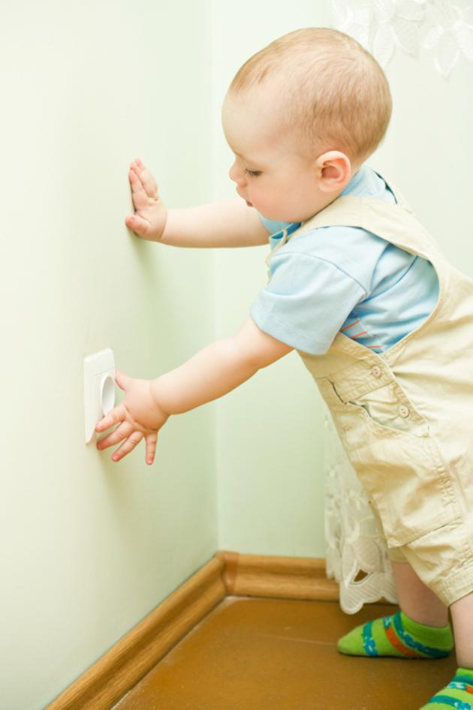
Has your mother ever called you urgently? How did he do it? What words has he used to get your attention?

Slide 3
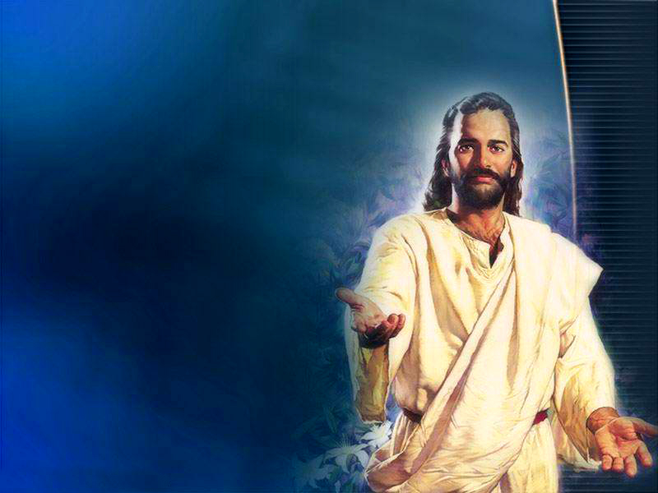
Jesus, when He wanted to give a special message, used a peculiar way of calling the person: repeating his name twice. Let's look at some examples of people who were called by Jesus twice.
I propose that, after each character, you fill in the blanks with your name (twice, of course) so that you can listen to what Jesus wants to say to you today.

Slide 4
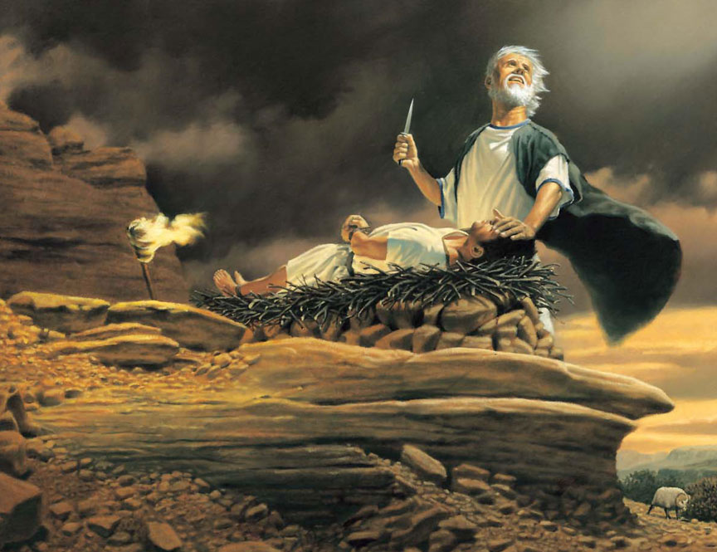
"And Abraham stretched forth his hand, and took the knife to slay his son. And the angel of the Lord called unto him out of heaven, and said, Abraham, Abraham: and he said, Here am I. And he said, Lay not thine hand upon the lad, neither do thou any thing unto him: for now I know that thou fearest God, seeing thou hast not withheld thy son, thine only son from me." Genesis 22:10-12
ABRAHAM
(your name here)
(your name here)
_______________, ______________; At this critical moment, stop and reflect so that you can see the solution I have provided for you.

Slide 5

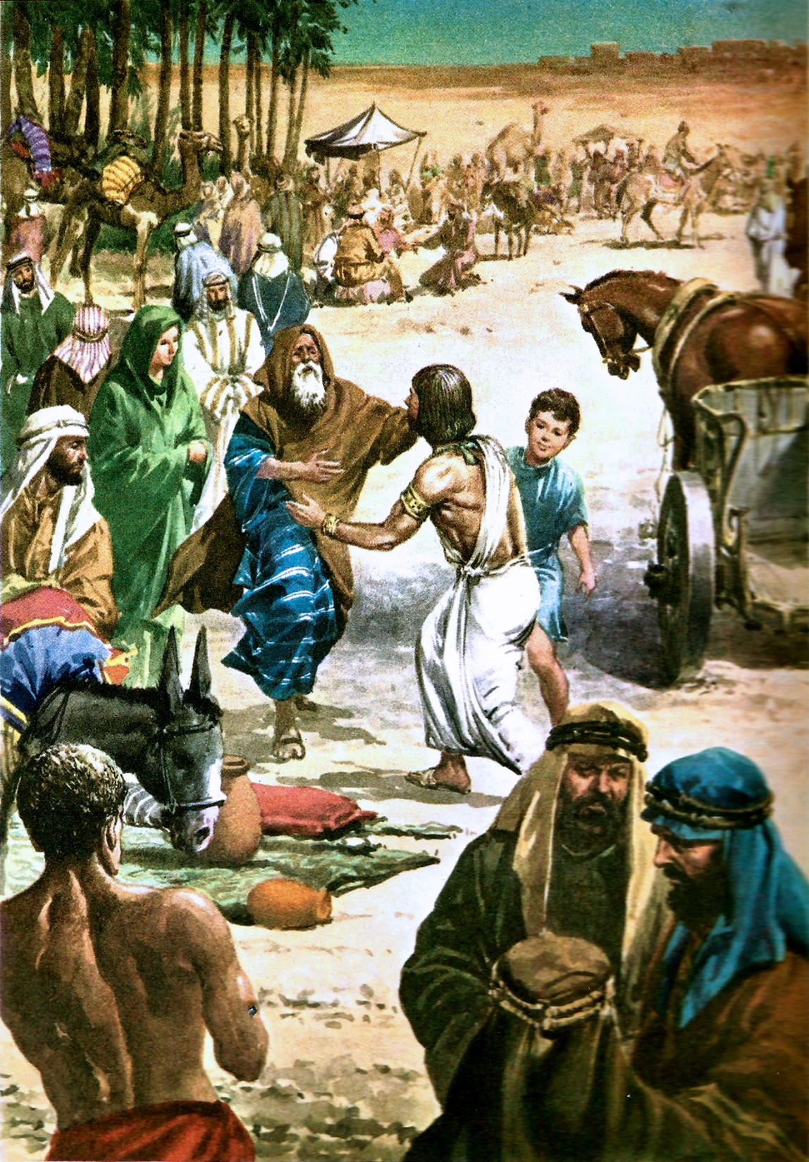
JACOB
"And Israel took his journey with all that he had, and came to Beersheba, and offered sacrifices unto the God of his father Isaac. And God spake unto Israel in the visions of the night, and said, Jacob, Jacob. And he said, Here am I. And he said, I am God, the God of thy father: fear not to go down into Egypt; for I will there make of thee a great nation.“
Genesis 46:1-3
_______________, ______________; I remove your fear, I give You My approval and I will be with you making My plans prosper.

Slide 6
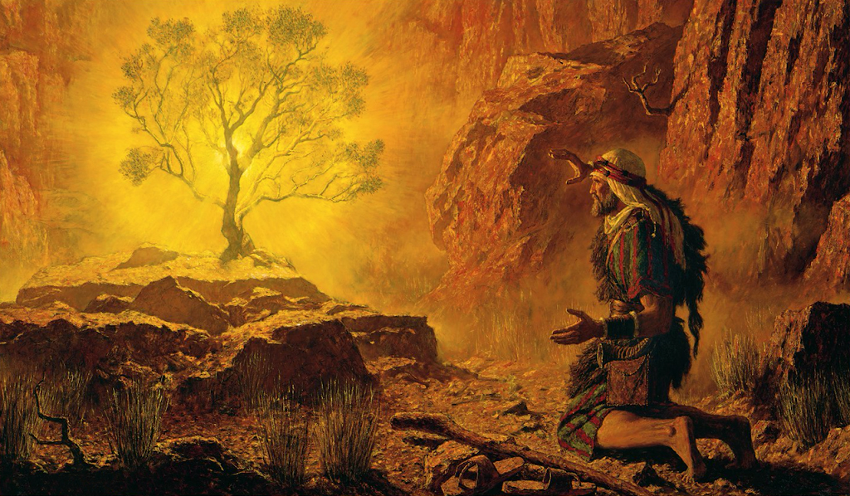
_______________, ______________; I show you My holiness and send you to carry out the mission that I have prepared for you.
MOSES
"And the angel of the Lord appeared unto him in a flame of fire out of the midst of a bush: and he looked, and, behold, the bush burned with fire, and the bush was not consumed. And Moses said, I will now turn aside, and see this great sight, why the bush is not burnt. And when the Lord saw that he turned aside to see, God called unto him out of the midst of the bush, and said, Moses, Moses. And he said, Here am I. And he said, Draw not nigh hither: put off thy shoes from off thy feet, for the place whereon thou standest is holy ground." Exodus 3:2-5

Slide 7

"Therefore Eli said unto Samuel, Go, lie down: and it shall be, if he call thee, that thou shalt say, Speak, Lord; for thy servant heareth. So Samuel went and lay down in his place. And the Lord came, and stood, and called as at other times, Samuel, Samuel. Then Samuel answered, Speak; for thy servant heareth.“
1 Samuel 3:9-10
SAMUEL
_______________, ______________; I call upon you with kindness and affection, wishing you to hear My message and share it with others.

Slide 8

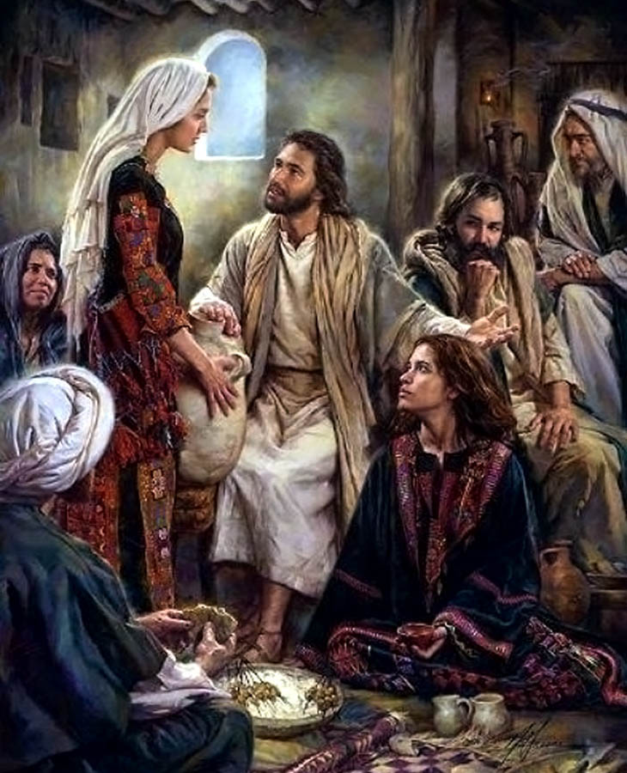
MARTHA
“But Martha was cumbered about much serving, and came to him, and said, Lord, dost thou not care that my sister hath left me to serve alone? bid her therefore that she help me. And Jesus answered and said unto her, Martha, Martha, thou art careful and troubled about many things: But one thing is needful: and Mary hath chosen that good part, which shall not be taken away from her.”
Luke 10:39-42
_______________, ______________; What sorrow and sadness I have! Why don't you want to spend more time with me? Why don't you take the time to read your Bible and talk to Me in prayer? I long for you to relate more to Me every day.

Slide 9

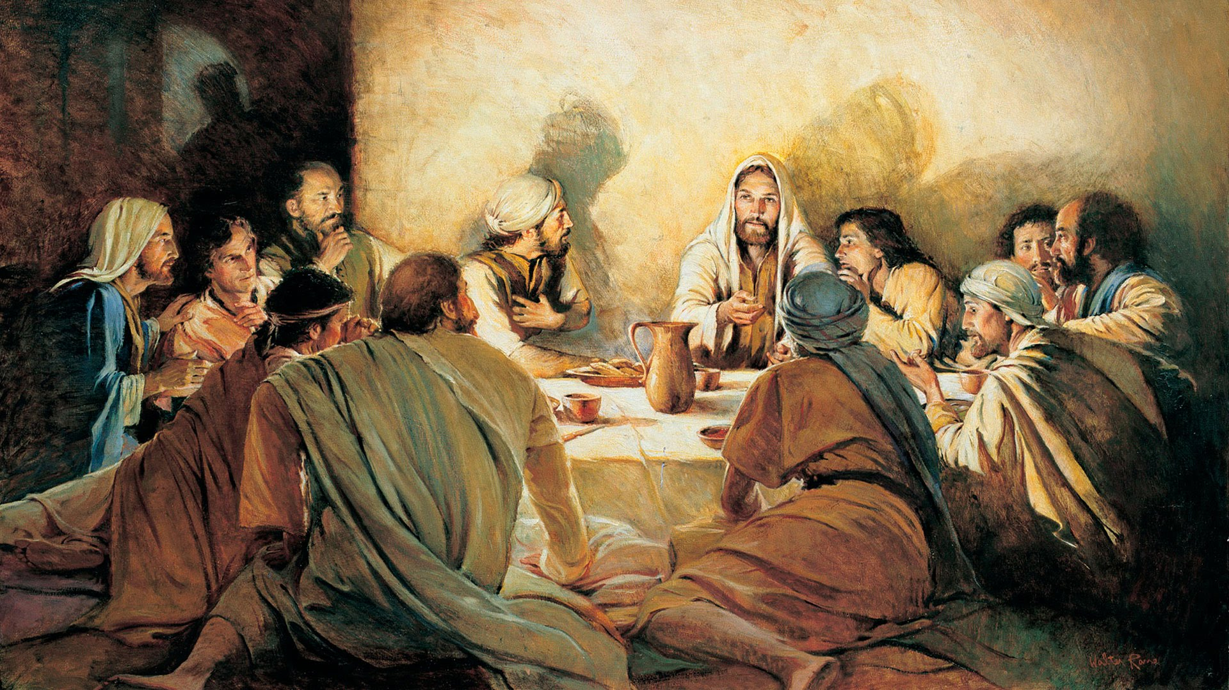
And the Lord said, Simon, Simon, behold, Satan hath desired to have you, that he may sift you as wheat: But I have prayed for thee, that thy faith fail not: and when thou art converted, strengthen thy brethren.
_______________, ______________; I have a personal interest in your trials and temptations, and I ask My Father that your faith may not fail.
SIMON PETER

Slide 10
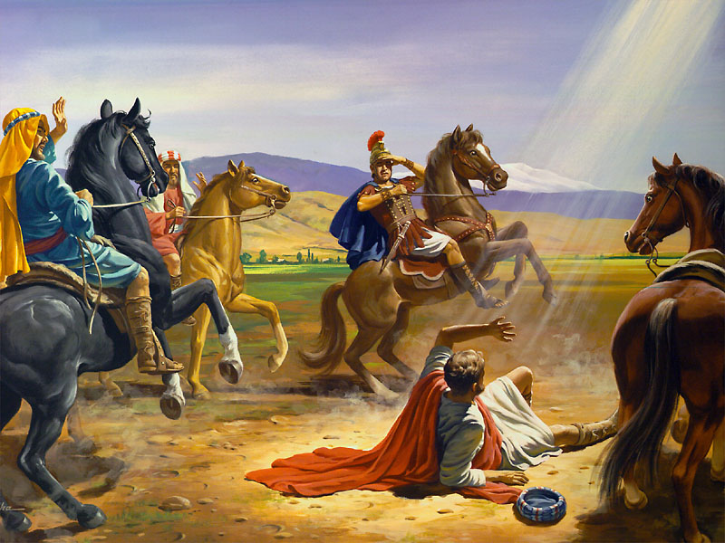
“And as he journeyed, he came near Damascus: and suddenly there shined round about him a light from heaven: And he fell to the earth, and heard a voice saying unto him, Saul, Saul, why persecutest thou me?”. Acts 9:3-4
SAUL
_______________, ______________; I am calling you with love, with power and with glory, to stop fighting against Me. From today, you will fulfill My purposes.

Slide 11
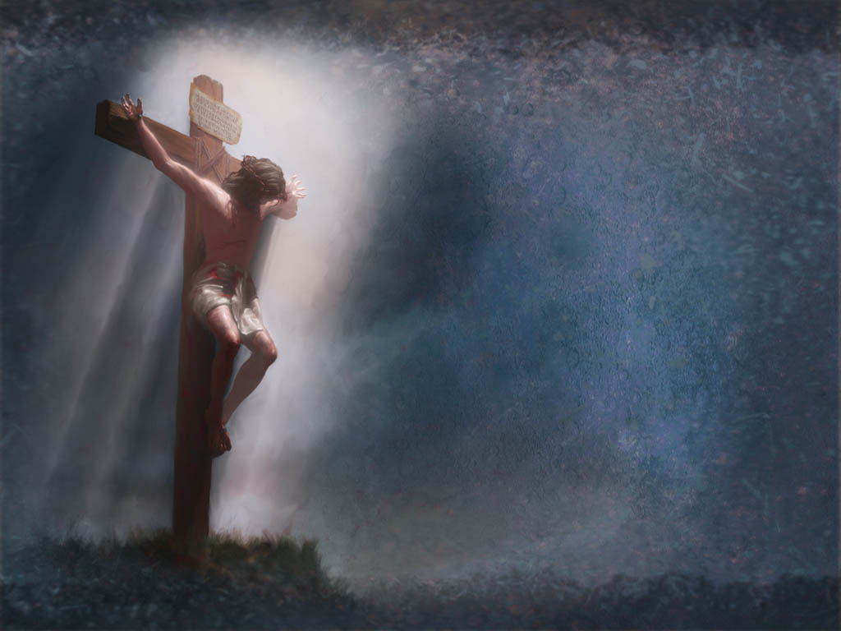
FATHER
“And about the ninth hour Jesus cried with a loud voice, saying, Eli, Eli, lama sabachthani? that is to say, My God, my God, why hast thou forsaken me?”
Matthew 27:46
_______________, ______________; follow My example and cry out to our heavenly Father. He will be there with you when you are in great distress or suffering.

Slide 12
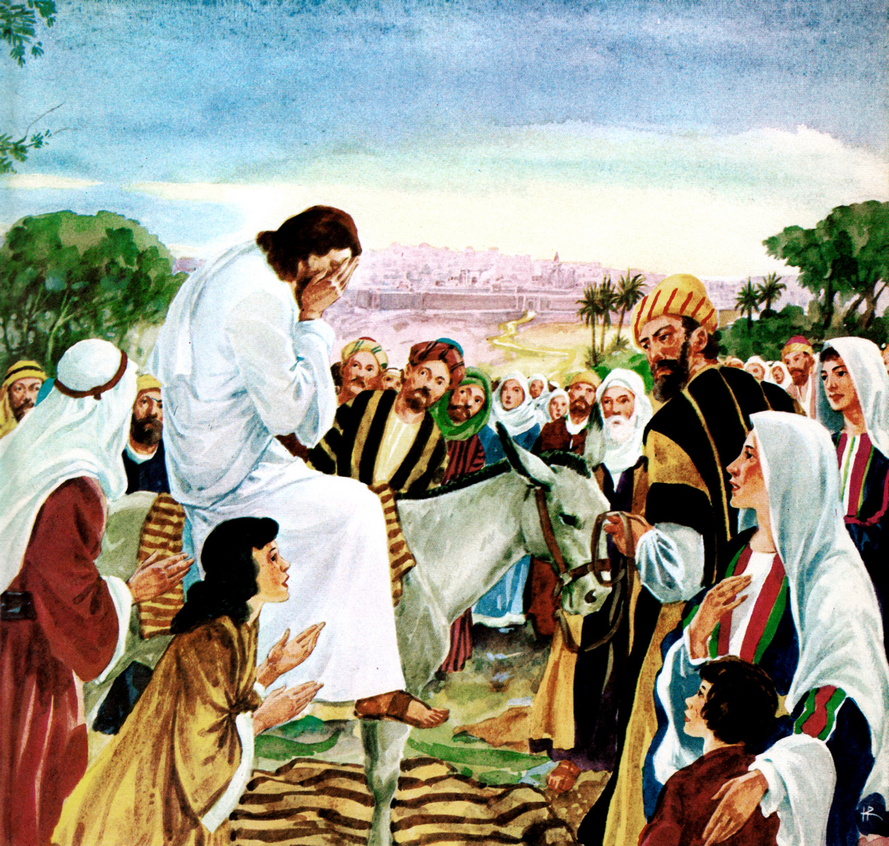
JERUSALEM
O Jerusalem, Jerusalem, thou that killest the prophets, and stonest them which are sent unto thee, how often would I have gathered thy children together, even as a hen gathereth her chickens under her wings, and ye would not!”. Mathew 23:37
_______________, ______________; I call you with a moving voice and with tender solicitude. I long for you to turn from your wicked ways. I don't want you to get lost. I want to give you salvation.

Slide 13

Matthew 25:21
Soon I hope to hear Jesus saying to me: Eunice, Eunice; well, good servant and faithful, you have been faithful over a few things, I will make you ruler over many things. Enter into the joy of your Lord.
I hope that very soon you too will be able to hear the words: _______________, ______________; Well done, good and faithful servant, you have been faithful over a few things, I will make you ruler over many things. Enter into the joy of your Lord.

Slide 14
Prepared by Sergio and Eunice. eunice@fustero.es www.fustero.es

